Slide 1
MISSION DISASTER

Slide 2
LIST OF CONTENTS
01
Problem statement
02
Proposed Solution
03
Modules
04
Flow diagram

Slide 3

MD?
Mission Disaster

Slide 4

Welcome!!
What is MD?
Mission Disaster (MD)System
is a web portal specially designed and developed to
manage disaster from it’s
precaution to recover it on a
single platform.

Slide 5

PROBLEM STATEMENT
Problems that are faced by the People.
Inform Officer’s about Disaster
01
There is no such system that inform officer’s of different level about the disaster.
No system to Raise Incident
02
There is no such platform where user can able to raise incident and there is no one who can verify that incident.
OTP verification
There is no such disaster related system in which OTP verification is provided.
03

Slide 6
PROBLEM STATEMENT
Problems that are faced by the company as well as customer.
No Graphical Representation of Disaster
04
We cannot able to view the no of occurences of particular disaster through Graph.
Rescued People and Lost People
05
05
No such a system exists that meets the rescued and lost people.
Not User Friendly
06
All the existing system are complex and not so handy to operate.
07

Slide 7
Proposed Solutions
We hereby provide some of the solutions of all the mentioned problems.
Inform Officer’s about Disaster
01
In our system, we will inform officers of national, zonal, state/
district level about the disaster through E-mail/SMS
We are adding option in our system that we will connnected with NGO and help peoples during Disaster in case of Emergency.
Cordinating with NGO:
02
Raise Incident
03
User can raise an incident of the disaster which will be verified by CMT that whether it is real/fake.
OTP Verification
04
In our portal, we are providing OTP verfication each time when new
User login for first time or User wants change their password or Forget their password.

Slide 8
Proposed Solutions
We hereby provide some of the solutions of all the mentioned problems.
Lost People and Rescued People
05
In our system, we are providing smart searching, user can search the people to whom they have lost during Disaster.
Google Map
06
We are allowing user to see nearby Disaster center through Google map in case of any emergency.
Graphical Representation of Disaster
07
User can able to view the graph that represents the area
which are affected by the disaster.
QR Code connected to Local host
08
In our system, we are providing feature to access Local host in ant e-device with help of QR code scanner.

Slide 9
MODULES
A module is a software component or part of a program that contains one or more routines.
User
ADMIN
CMT
User
ADMIN
Compalin Management Team
A user is an individual that access the system.
The Admin will manage the whole portal
CMT handle rescued and lost people details.

Slide 10
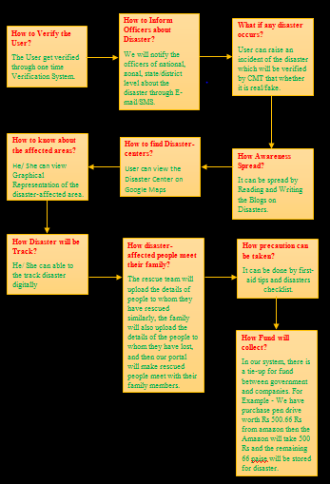
FLOW
DIAGRAM

Slide 12
Thank you
For having us

